Slide 1
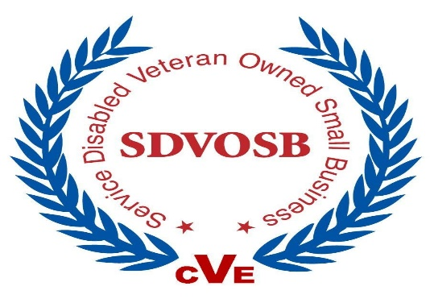
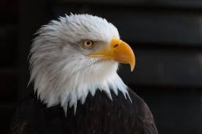


AGS LLC
ANALYTICAL GOVERNMENT SOLUTIONS
Defensible, highly accurate analytical products and decision analysis for Decision Makers
Introduction to C++
Day 1
13-17 December 2021
Pat Barton.
President/CEO, PES LLC
A Certified Service Minority
Owned Small Business
E. G. “Gil” Dickens, Jr.
President/CEO, AGS LLC
A Certified Service Disabled Veteran
Owned Small Business
(SDVOSB)
V 062419 egd

Slide 2
DAY 5
Today’s Objectives and Topics
Data Visualization
Datetime Objects
Database Operations
Pandas + Machine Learning
Monte Carlo Simulation
Machine Learning Ecosystem
Miscellaneous Topics

Slide 3

Well, you’ve survived so far. Congratulations.
Today, we’re going to look into some more visualization tools and some of Pandas’ more interesting database-related and time series manipulation capabilities.
We’ll then look at some real data analysis using features built into Pandas, a NumPy-only implementation of Monte Carlo simulation, a data modeling application from the SciPy library, and some of the more advanced elements of Python’s data science ecosystem.
This we numerically-intensive, but with some really interesting graphics.
Enjoy.

Slide 4

21 Data Visualization
21.1 Matplotlib with Pandas methods
21.2 Working With Basic Matplotlib Charts
21.3 Compound and Customized Chart Types
21.4 Visualization Tools for Exploration
21.5 Other Visualization Tools
21.6 Exercise

Slide 5

22 Datetime Objects
22.1 Basic Time Series Operations
22.2 Introspecting Time Series
22.3 Tools for Holidays, Business Days, Etc.
22.4 Combining Data From Different Series
22.5 Time Shifting
22.6 Exercise:

Slide 6
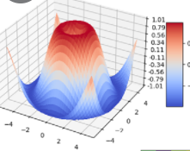
23 Pandas Database Ops
23.1 SQL Operations and Pandas Methods
23.2 Pivot tables and Cross-tabulations
23.3 Aggregating Data (Joins)
23.4 Complex Queries
23.5 Exercise

Slide 7

24 Pandas + Machine Learning Tools
24.1 What is LDA?
24.2 Getting to Know the Data
24.3 Exploring Data Integrity
24.4 Applying the LDA Model
24.5 Recap of the Analysis

Slide 8

25 Monte Carlo Simulation
25.1 Basics
25.4 A Casino Application
25.5 Sampling an Unknown Distribution
25.6 Generate a Distribution
25.7 Making Observations
25.8 Explore the Dataspace
25.9 Refining the Exploration
25.10 Recap
25.11 Gradient Search
25.12 Exercise

Slide 9

27 Miscellaneous Topics

Slide 10
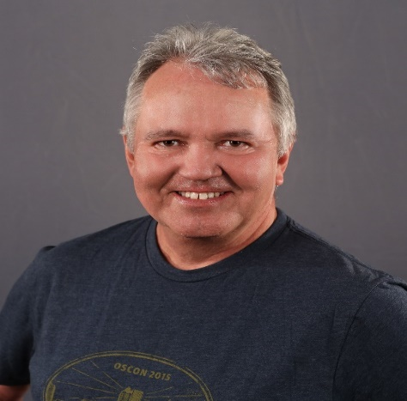
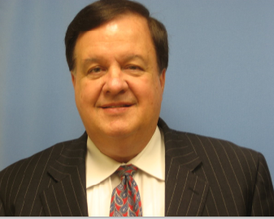
AGS LLC
ANALYTICAL GOVERNMENT SOLUTIONS
Defensible, highly accurate analytical products and decision analysis for Decision Makers
The AGS Staff and Instructors
Pat Barton and Gil Dickens
Wish to express our thanks to our Dahlgren SWC and Navy Community
For Joining Our Presentation of
AGS APPLIED PYTHON COURSE
July 19th – July 23rd 2021
E. G. “Gil” Dickens, Jr.
President/CEO, AGS LLC
A Certified Service Disabled Veteran
Owned Small Business
(SDVOSB)
V 072321 egd

